Slide 1
Category review: Chips
June 2020
Retail Analytics
Brand note: If client logo is not required, use alternate title page layout right click slide thumbnail > Layout > Title

Slide 2
Notes:
To view Privacy video explaining how important data privacy is to Quantium, please click here: https://www.youtube.com/watch?v=Zq1QDAkoRzU
or here Q:\Company Reference\Brand & Design\Brand videos\Q Privacy.mp4
At Quantium, we believe that data is the behavioural footprint of humanity and that it has to be treated with the utmost care and responsibility.
Histories, attitudes, indeed lives are stored within it in ways that aren’t always apparent – and that’s what makes its potential so powerful.
To work with it responsibly, sensitively, we set ourselves the highest data privacy protection and governance standards.
We have spent 17 years perfecting privacy-by-design and secure-by-design principles. Central to this is not holding any personally identifiable information about people –
we neither receive it, and put the necessary protections in place to be unable to decipher it.
Every aspect of handling data is safeguarded: from its de-identification, to its encryption – data security is paramount and of the highest grade.
We pride ourselves on gaining the trust of iconic organisations around the world through years of securely working with their data,
and in turn the trust that builds with their stakeholders.

Slide 3
Executive summary
01
Target store layout to Mainstream- Young and Mid-age Singles/Couples
Sales are mainly due to Budget-Old Families, Mainstream-Young Single/Couples, and Mainstream Retirees
These group of people like the Kettle Brand and chips that are in the 175g pack size
02
Trial stores were successful
Control store 233, 138, and 7 for trial store 7, 88, 86 showed significant difference in sales and total customers
Store 86 did not perform as well in terms of sales, however customers increased significantly.

Slide 4
01
Category

Slide 5
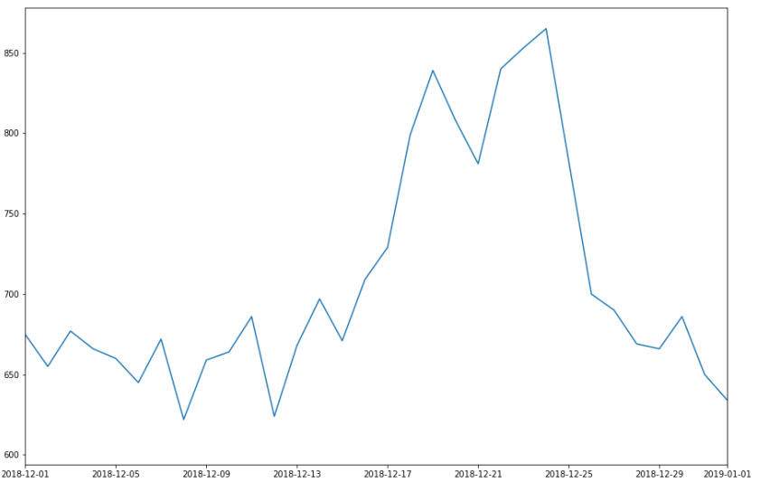
Overview:

Slide 6
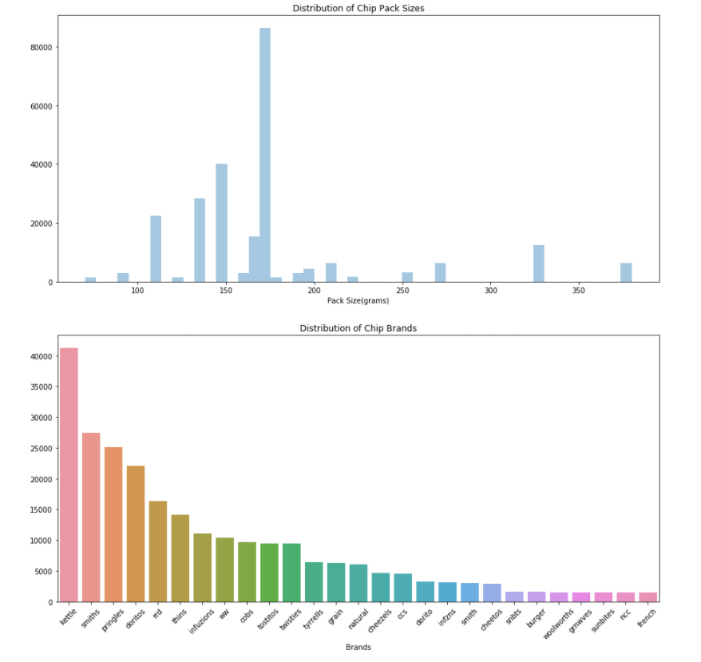
170g and Kettle seems to be the most popular

Slide 7
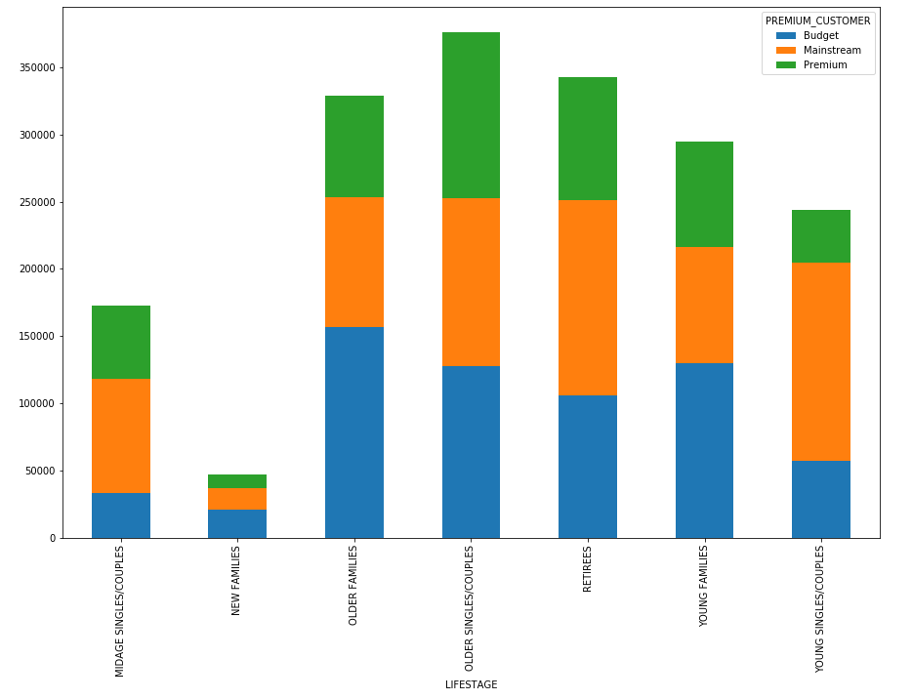
Stretch: Mainstream Mid-Age and Young Singles/Couples dominates

Slide 8
02
Trial store performance

Slide 9
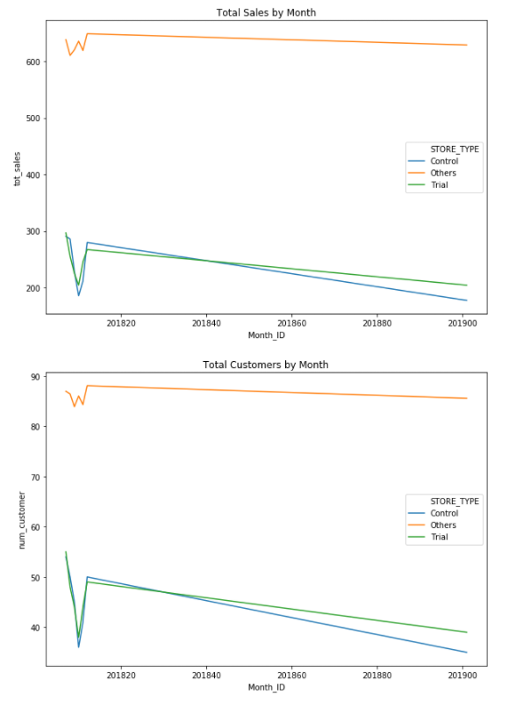
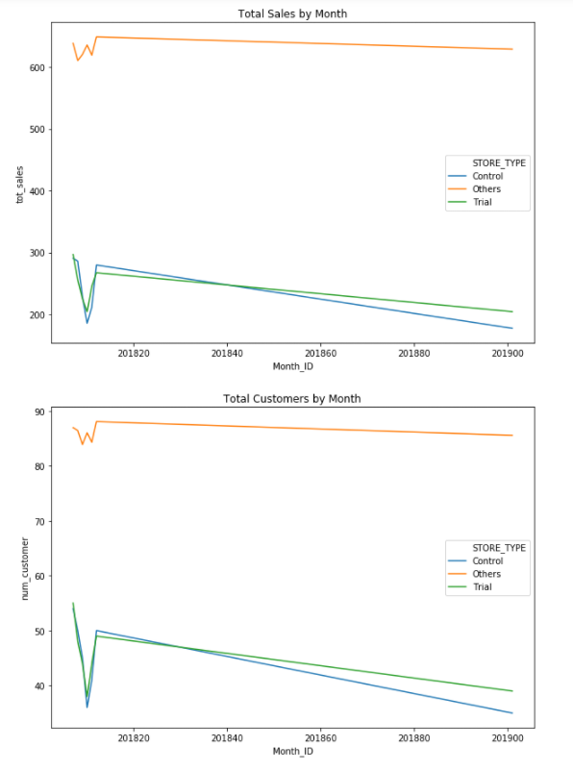
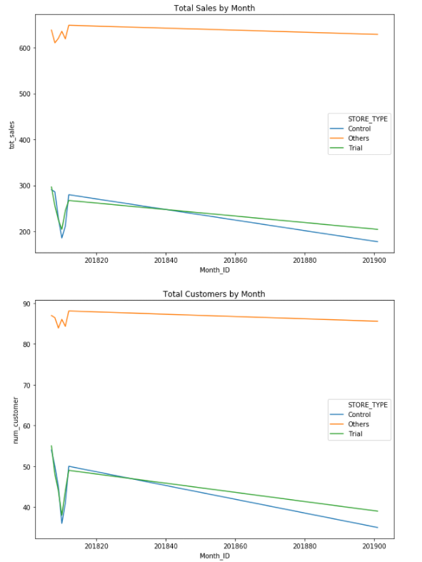
Explanation of the control store vs other stores
77 vs 233
86 vs 138
88 vs 7

Slide 10
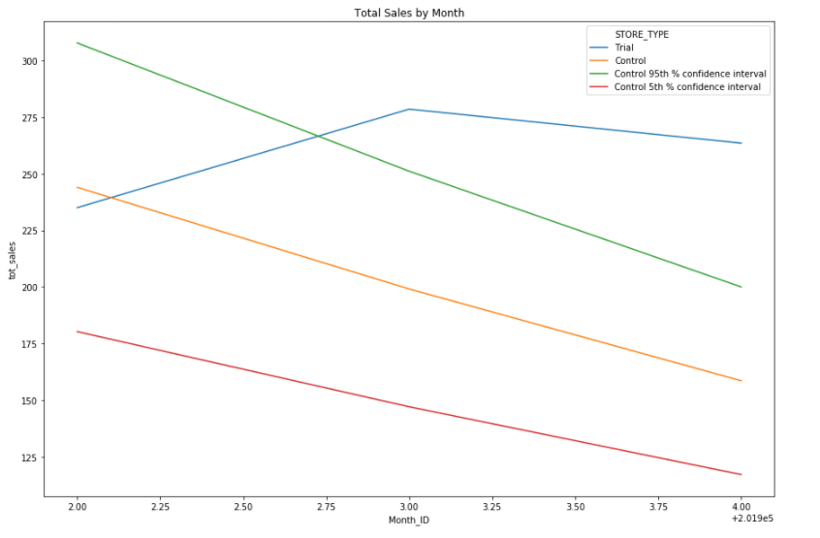
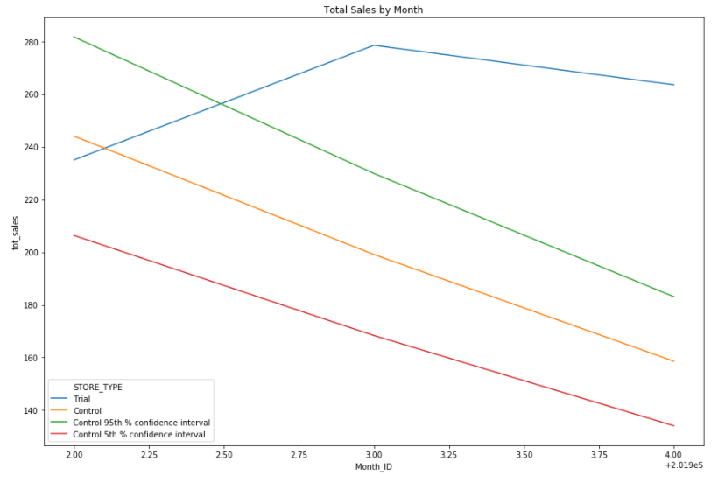
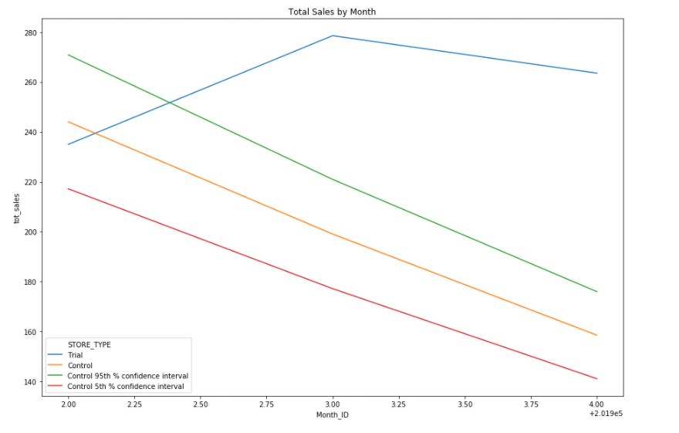
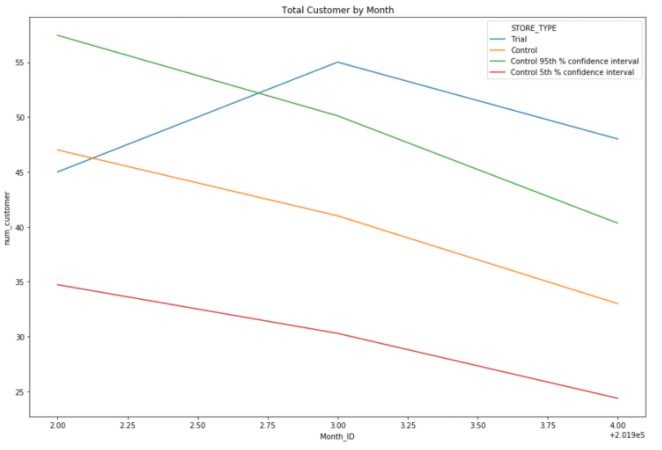
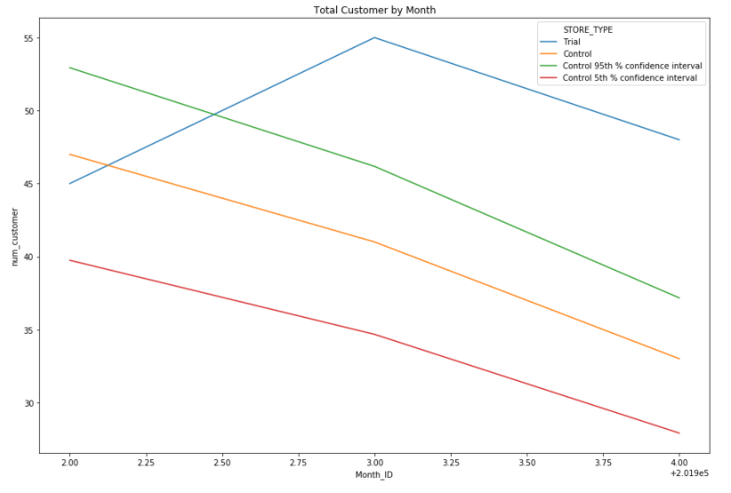
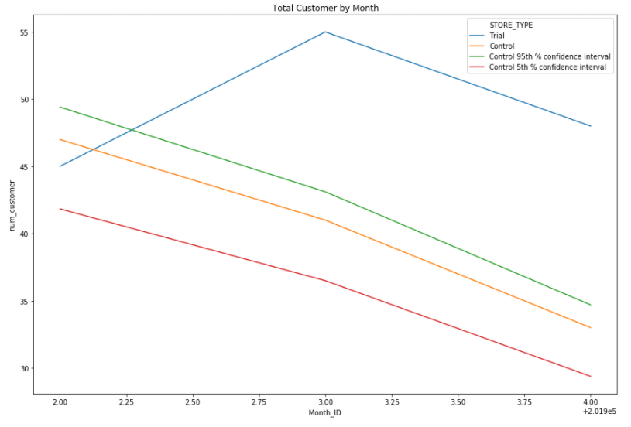
Successful Trials
Trial Store 77
Trial Store 86
Trial Store 88

